Slide 1

NodeJS Demo Class
Soumarshi

Slide 2

Who Am I
Soumarshi Nag Biswas (Soum)
14 years of experience
2007 BTech Graduate from West Bengal University of Technology
Started my career in Hewlett Packard (erstwhile HP)
Currently working as a solution architect in a consultancy startup in Bangalore for multiple clients.
Worked on .NET/Unix/Java frameworks before moving to Cloud and OpenSource technologies in 2014.
Full Stack Architect (FrontEnd and Backend Stacks)
Actively working on NodeJS from last 7 years.
Mentoring and coaching freshers/interns/tech enthusiasts/developers in NodeJS since 2017

Slide 3
Before we jump onto Node
Do you know application programming?
Do you know Javascript? Or any Programming language?
Are you aware of Server side platform?

Slide 4
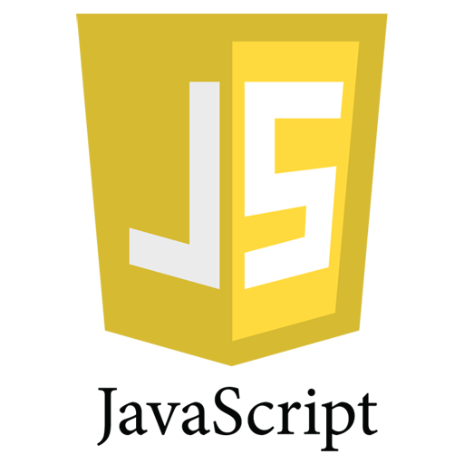
Let's do some Javascript!!!
function doYouKnowJS(developer) {
var javascriptURL = 'https://www.w3schools.com/js/default.asp'
if (developer && developer.knowledge === 'javascript') {
console.log('Developer knows basic javascript, a prerequisite for NodeJS')
} else {
console.log('Developer needs to learn basic javascript, may be from :: ' + javascriptURL)
}
}
let param = {
knowledge: "java"
}
doYouKnowJS(param)

Slide 5
What isn't NodeJS?
Framework
Programming Langauge

Slide 6
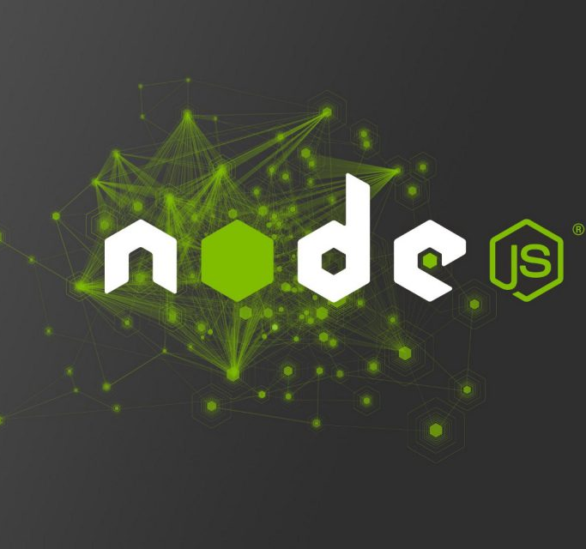
What is NodeJS?
NodeJS is a runtime environment for running javascript applications outside the browser, so javascript on your backend

Slide 7
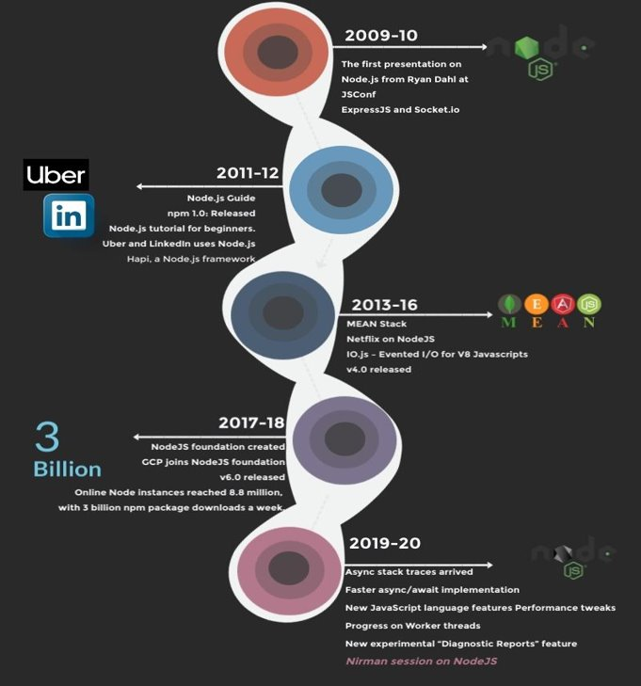
History Of NodeJS

Slide 8

Features of NodeJS
Asynchronous and Event Driven
Very Fast
Single Threaded but Highly Scalable
No Buffering
License − Node.js is released under the MIT license.
Notes:
Asynchronous and Event Driven − All APIs of Node.js library are asynchronous, that is, non-blocking. It essentially means a Node.js based server never waits for an API to return data. The server moves to the next API after calling it and a notification mechanism of Events of Node.js helps the server to get a response from the previous API call.
Very Fast − Being built on Google Chrome's V8 JavaScript Engine, Node.js library is very fast in code execution.
Single Threaded but Highly Scalable − Node.js uses a single threaded model with event looping. Event mechanism helps the server to respond in a non-blocking way and makes the server highly scalable as opposed to traditional servers which create limited threads to handle requests. Node.js uses a single threaded program and the same program can provide service to a much larger number of requests than traditional servers like Apache HTTP Server.
No Buffering − Node.js applications never buffer any data. These applications simply output the data in chunks.
License − Node.js is released under the MIT license.

Slide 9
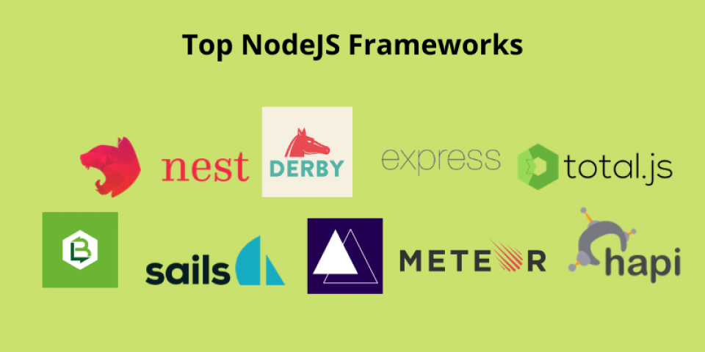

Slide 10
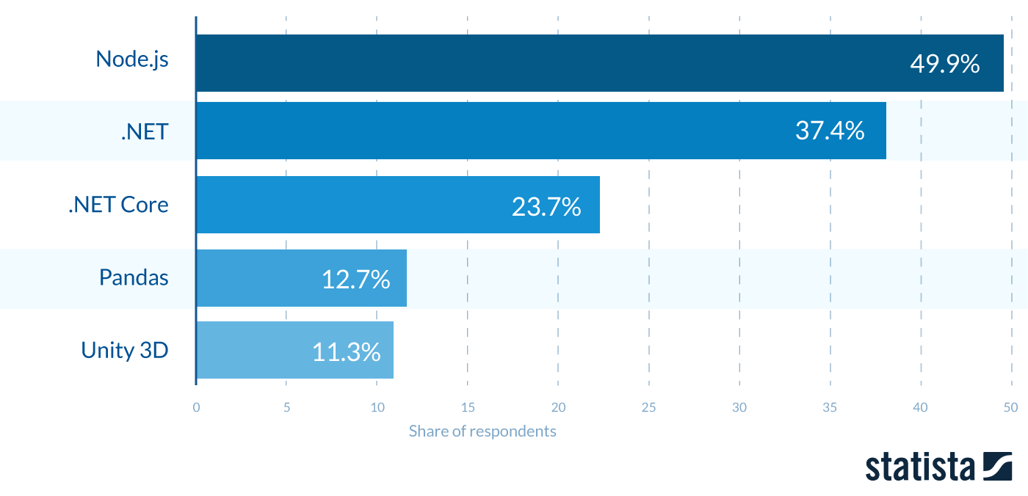
Popular Frameworks among developers

Slide 11
Where to use NodeJS?
I/O bound Applications
Data Streaming Applications
Data Intensive Real-time Applications (DIRT)
JSON APIs based Applications
Single Page Applications
Notes:
Where Not to Use Node.js?
It is not advisable to use Node.js for CPU intensive applications.

Slide 12
Performance of Node
35% faster response time
Built twice as fast with fewer people
33% fewer lines of code
40% fewer files
2x request/sec

Slide 13

Let's Code
https://www.tutorialspoint.com/execute_nodejs_online.php​
Visual Studio Code​
NetBeans​
Eclipse​
Atom​
etc...

Slide 14
Explanation of Demo
Import Required Module
Create Server
Testing Request & Response
$ node <path of js file>
Verify the Output. Server has started.
Server running at http://127.0.0.1:8081/
Notes:
Step 1 - Import Required Module
We use the require directive to load the http module and store the returned HTTP instance into an http variable as follows −
var http = require("http");
Step 2 - Create Server
We use the created http instance and call http.createServer() method to create a server instance and then we bind it at port 8081 using the listen method associated with the server instance. Pass it a function with parameters request and response. Write the sample implementation to always return "Hello World".
http.createServer(function (request, response) { // Send the HTTP header // HTTP Status: 200 : OK // Content Type: text/plain response.writeHead(200, {'Content-Type': 'text/plain'}); // Send the response body as "Hello World" response.end('Hello World\n'); }).listen(8081); // Console will print the message console.log('Server running at http://127.0.0.1:8081/');
The above code is enough to create an HTTP server which listens, i.e., waits for a request over 8081 port on the local machine.
Step 3 - Testing Request & Response
Let's put step 1 and 2 together in a file called main.js and start our HTTP server as shown below −
var http = require("http"); http.createServer(function (request, response) { // Send the HTTP header // HTTP Status: 200 : OK // Content Type: text/plain response.writeHead(200, {'Content-Type': 'text/plain'}); // Send the response body as "Hello World" response.end('Hello World\n'); }).listen(8081); // Console will print the message console.log('Server running at http://127.0.0.1:8081/');
Now execute the main.js to start the server as follows −
$ node main.js
Verify the Output. Server has started.
Server running at http://127.0.0.1:8081/
Make a Request to the Node.js Server
Open http://127.0.0.1:8081/ in any browser and observe the following result.

Slide 15


Slide 16

Next Steps
Book a class with me for detailed course.
Agenda of the whole class attached here.

